Slide 1
Graduation Project
Elevator Control Software Module
GL Embedded ProCamp
Oleksandr Ivanov
Kharkiv 2021v 201
iv 2021

Slide 2
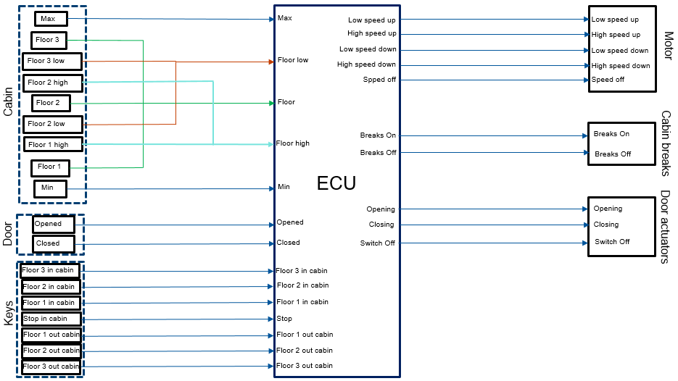
SYSTEM COMPONENTS

Slide 3
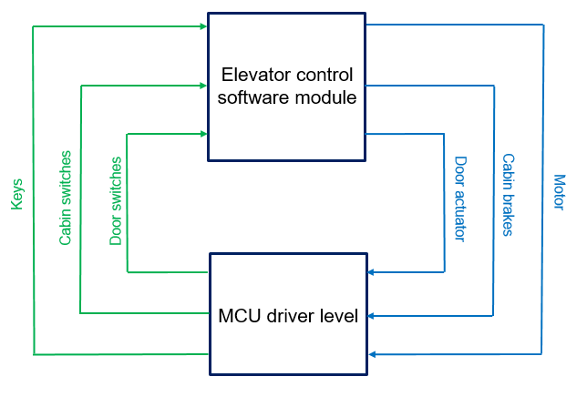
INTERACTION WITH THE DRIVER LEVEL

Slide 4
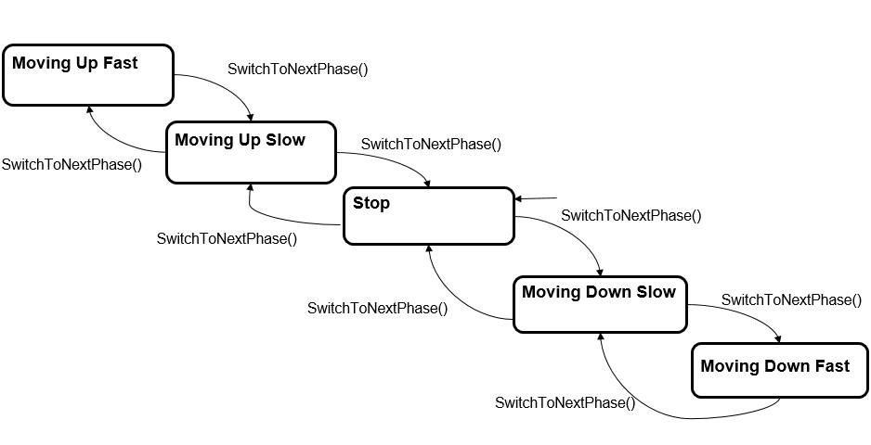
CABIN’S STATE MACHINE

Slide 5
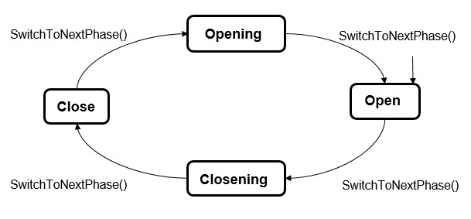
DOOR’S STATE MACHINE

Slide 6
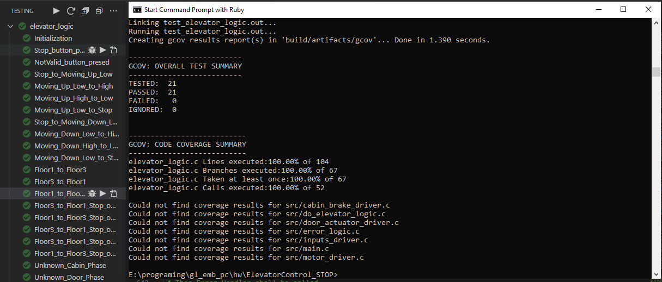
TEST RESULTS

Slide 7
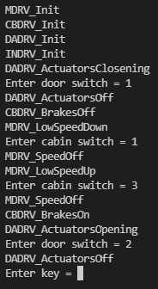
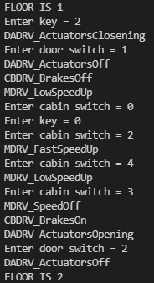
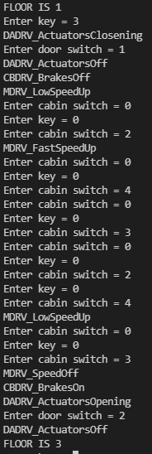
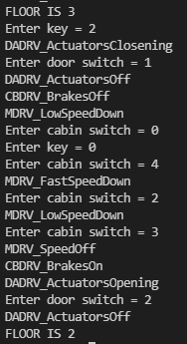
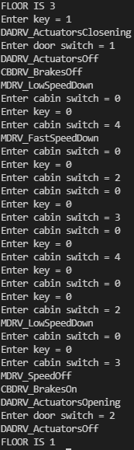
SIMULATION DRIVERS LEVEL WITH SCANF
Power On / Initialization
Moving Up from 1st to 2nd
Moving Up from 1st to 3rd
Moving Down from 3rd to 2nd
Moving Down from 3rd to 2nd
Door switches:
Closed = 1
Opened = 2
Keys:
Outcabin floor 3 = -3
Outcabin floor 2 = -2
Outcabin floor 1 = -1
Not pressed = 0
Outcabin floor 1 = 1
Outcabin floor 2 = 2
Outcabin floor 3 = 3
Stop = 4
Cabin switches:
Max = 5
Low = 4
Floor = 3
High = 2
Min = 1
No = 0

Slide 8
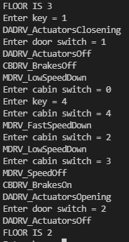
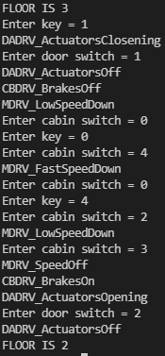
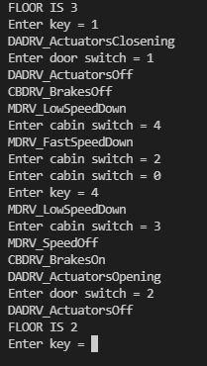
SIMULATION DRIVERS LEVEL WITH SCANF
Moving Up from 3rd to 1st to with stop on 2nd
Door switches:
Closed = 1
Opened = 2
Cabin switches:
Max = 5
Low = 4
Floor = 3
High = 2
Min = 1
No = 0
Keys:
Outcabin floor 3 = -3
Outcabin floor 2 = -2
Outcabin floor 1 = -1
Not pressed = 0
Outcabin floor 1 = 1
Outcabin floor 2 = 2
Outcabin floor 3 = 3
Stop = 4

